Slide 1
Recipe:
Envision the next five years of my career
Use mock up cover story

Slide 2




what is top-of-mind for you
Self learning CI/CD technology example: k8s, AWS, AzureDevOps
Learn Java/JS/Python
Using innovative tool
Laptop
Allow admin right
Gadget for work
Certification on az-104
Fullstack QA
Networking among colleagues
Efficient tooling and process
Softskill – engage others
Helping others
Cross -functional
Location/convenience
On the job training
Organization
culture
benefits
Servant leadership
recognition
Mastery of skills thro on the job training
Pay incentive
Stability
Public speaking
no micromanagement
supportive management
Team building
purpose
Technical training course eg: AWS
autonomy
teamwork
Consultancy role
growth mindset
customer interaction
Passion
fewer meetings
Career advancement
Product development
scrum training
Certification on az-500
Flat hierarchy
Flexibility of working hour
BDD training material
Certification on AZ400
Write tech blog on own website

Slide 4
CICD Advocate
To be a CICD Advocate in 5 years time
Current: test automation lead practitioner

Slide 5
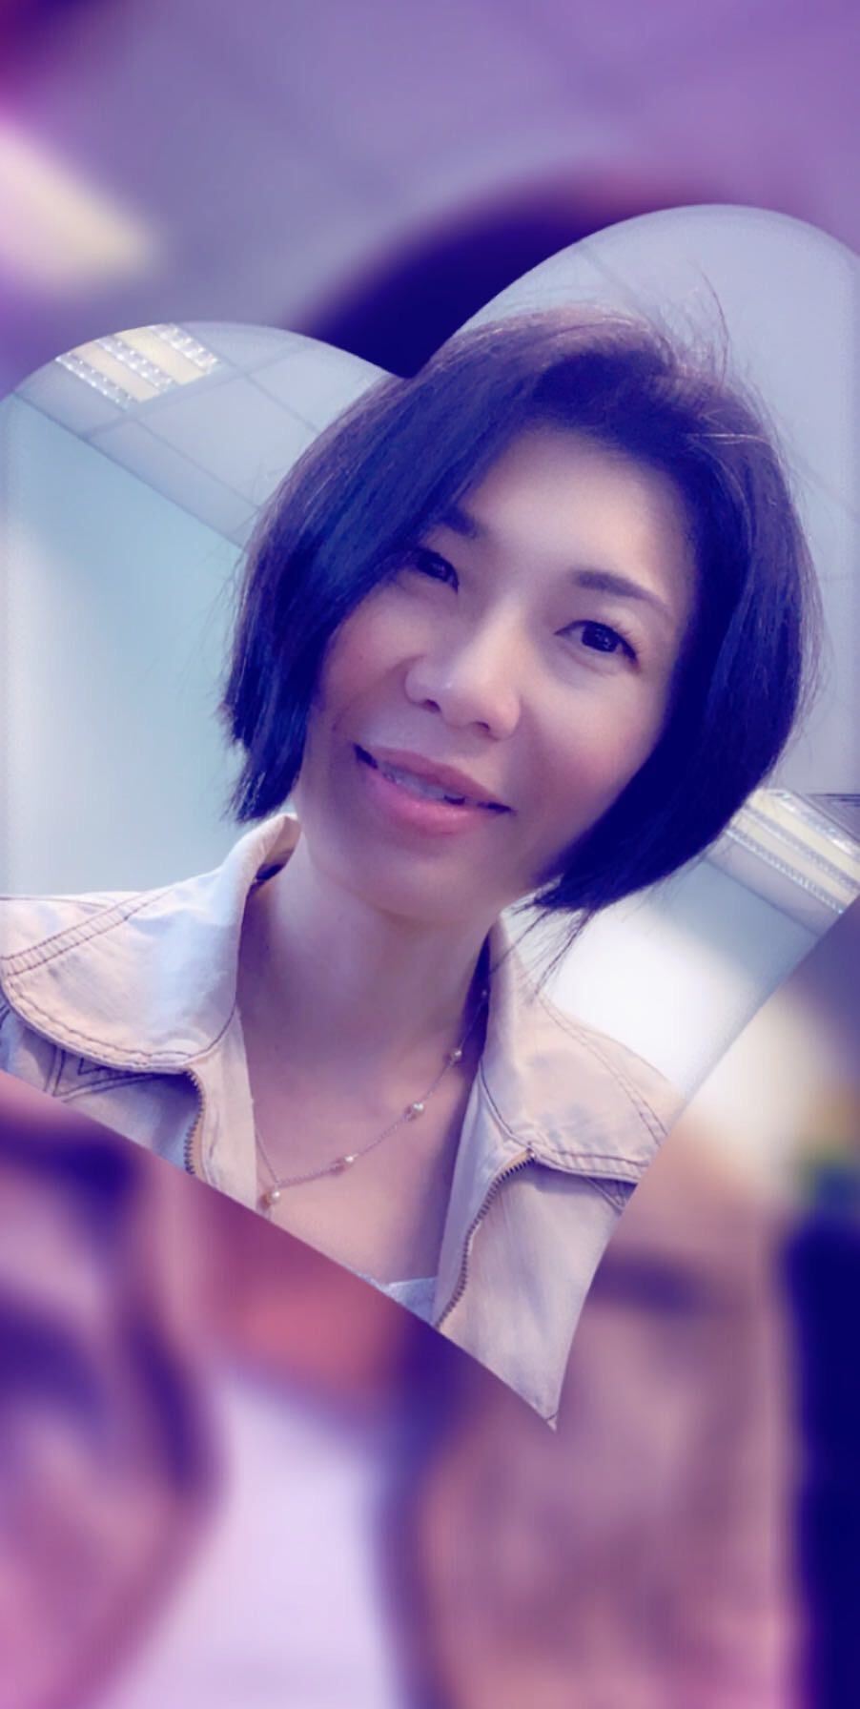
About Me (2021)
I have a total of 20+ years in the IT industry
i started software development engineering in C/C++ with many years in release management and test automation development in backend database client and server enterprise product mainly unix/linux environment.
Past 7 years I am more focus on web and mobile app automation including UI, and API testing framework using Java/JS/TS.
My interest is helping team to overcome agile transformation challenges by adopting devOps approach and setup test automation in the CICD pipeline.

Slide 6


CICD/Test Automation (2025)
Bio
LayMui is a Senior devTestOps CICD Advocate focusing on Continuous Quality. She does extensive work in BDD test automation and onboard test automation on the CICD pipeline. LayMui has an extensive background in software development and release management. She also blog on tech related to Testing and DevOps and hold public talk to share her experience.
Her contact:
Email: mui_ume@hotmail.com Github: https://github.com/LayMui/ LinkedLn: https://www.linkedin.com/in/laymui-toh-632a76141/
Web site: https://laymui-toh.com

Slide 7
Use schematic diagram to reach there
Onboard serenityBDD and CICD aws device farm for msta squad
Onboard serenityBDD test framework/device farm CICD for conD squad
Pact test POC with 5G backend team
Automate CI pipeline using bitbucket script
CICD tech: k8s, Jenkins declarative script
AWS devOps engineering course review
AZ400 exam certification
5 June 2021

